Slide 1
Introduction
July 2019
Guy Harrison
CTO ProvenDB

Slide 2
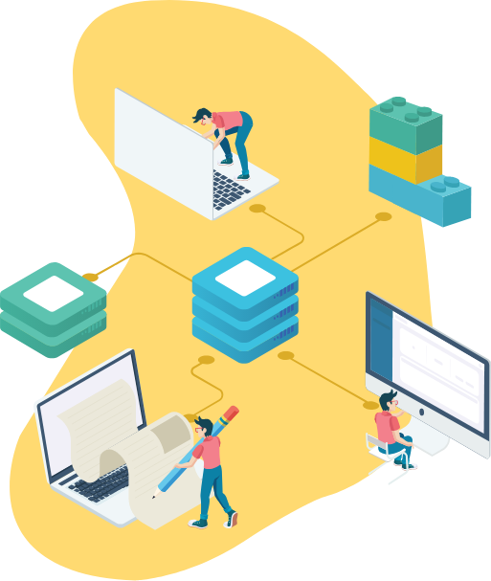
About ProvenDB
Blockchain
ProvenDB bridges the gap between Database and Blockchain technology.
ProvenDB enables the rapid development of high-performance Blockchain applications.
ProvenDB can add Blockchain capabilities to any existing MongoDB application.
ProvenDB applications have immutability, integrity and data provenance guaranteed by Blockchain technology.
MongoDB
ProvenDB

Slide 3


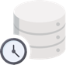



Why it matters
Blockchain
Database
ProvenDB
Blockchain can provide unprecedented guarantees of data immutability, integrity and provenance.
Unfortunately, Blockchain is the world’s worst database: slow, expensive and hard to work with.
Blockchain applications can’t use a traditional DBMS because DBMS lacks immutability of the blockchain.
ProvenDB solves this dilemma.
Tamper Proof
Immutable History
Developer Friendly
Economical
Performant

Slide 4




The Opportunity
Legal record keeping
Blockchain solutions spend growing from $2.9B in 2019 to $12.4B in 2022 (IDC)
Intellectual Property and Media Management Solutions
Data management project include about 40% of blockchain project spend ($5B in 2022) Gartner: G00325744
“Through 2021, 95% of data management projects using blockchain will fail due to either performance challenges or misapplication of the technology” (Gartner)
Audit and Access Management Systems
Financial and Accounting Systems
ProvenDB offers the easiest and fastest way to deliver high-performance blockchain-enabled data management solutions
Government and Regulatory Applications

Slide 5
Total Addressable Market: $USD500M in 2022
Blockchain spending from $2.9B -> $12B 2019-2002 (IDC)
RDBMS spending from $41B -> $51B 2019-2022 (IDC)
40% of value in Blockchain data applications (Gartner)
– public record, intra-company, regulatory, etc.
5-10% of total that spend on tooling and infrastructure software
12B x 40% x 5% =~ $500M in 2022.
Blockchain spend - $12B
Immutable DB - $500M
DBMS Spend- $51B

Slide 6
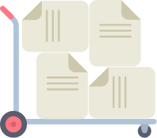



Business Plans
Rollout
Marketing
Channels
Revenue
Early Adopter Version released in May – 270 signups
Commercial service with paid plans Q4 2019
Targeting 100 commercial customers by Q4 2020
Partnership with MongoDB
FT US-based evangelist and business development
Social media marketing campaigns
Developers of new Blockchain apps
Migration of existing apps (esp. Mongo apps)
Vertical partnerships (security, legal, accounting, etc.)
Subscription based DBaaS model
AAR $10K-$50K/customer/year
Free tier (1GB storage)
provendb.com
info@provendb.com

Slide 7
Details

Slide 8

Go To Market
Bottom Up
Migration
Encourage developers to build Blockchain applications with ProvenDB. Long term this is essential, but takes time…
Entice exciting applications – especially those based on MongoDB to migrate to ProvenDB and add Blockchain capabilities.
Top Down
Partner
Persuade Blockchain project owners to build new Blockchain applications on ProvenDB
Build strategic and technology partnerships with platform providers. Most important strategy partner is MongoDB. Citizens Reserve is a possible technology partner.

Slide 9
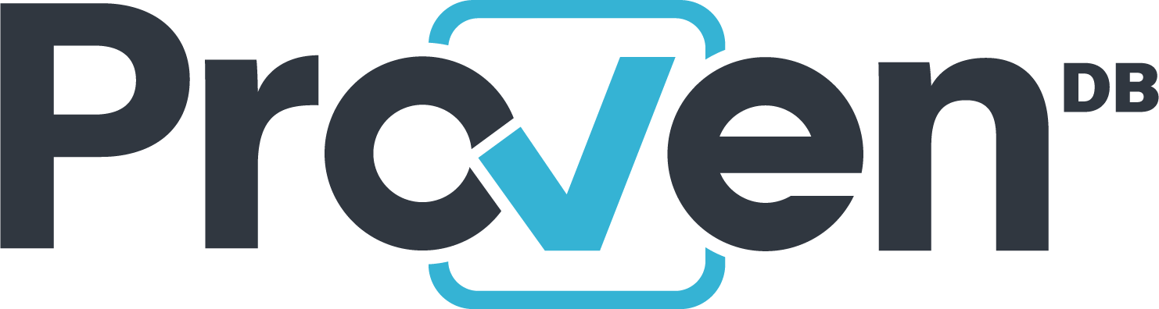

Competitive Landscape
MongoDB compatible
Public blockchain, centralized DBMS
DB as a Service
Proofs are based on bitcoin Blockchain cryptography and Proof of Work
Not hackable
MongoDB compatible
Private blockchain, replicated DBMS
On-premise model (each participant must run a node)
Proofs are based on mutual trust
Hackable if >1/3rd of nodes are compromised
$5.4M Series A
Proprietary API, document data model
Private blockchain, distributed DBMS
On-prem or as a Service
Proofs are based on mutual trust or trust of Fluree hosted platform
Hackable from within network
$4.7M seed
Proprietary API, ledger data model
Centralized ledger (not a blockchain)
AWS Service
Proofs are based on trust of Amazon
Hackable from within Amazon

Slide 10
Technology Roadmap
1.0 (Q2 2019)
Bitcoin Blockchain proofs
Immutable versions
Freeware option
ProvenDocs demo
1.1 (Q4 2019)
Commercial option
On Prem deploy
Ethereum support
Private Key signing
Document UI and API
2.0 Q2 2020
BYO DB (replication stream mode)
3.0 Q3 2020
Smart contract transaction consensus model.

Slide 11
Demo

Slide 12
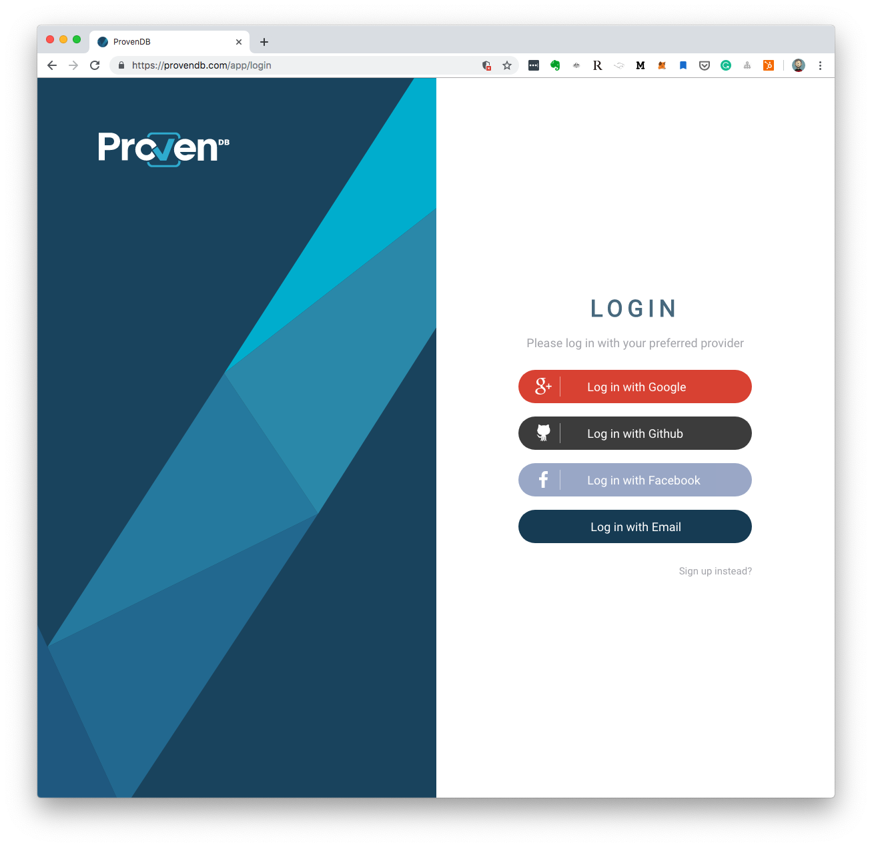
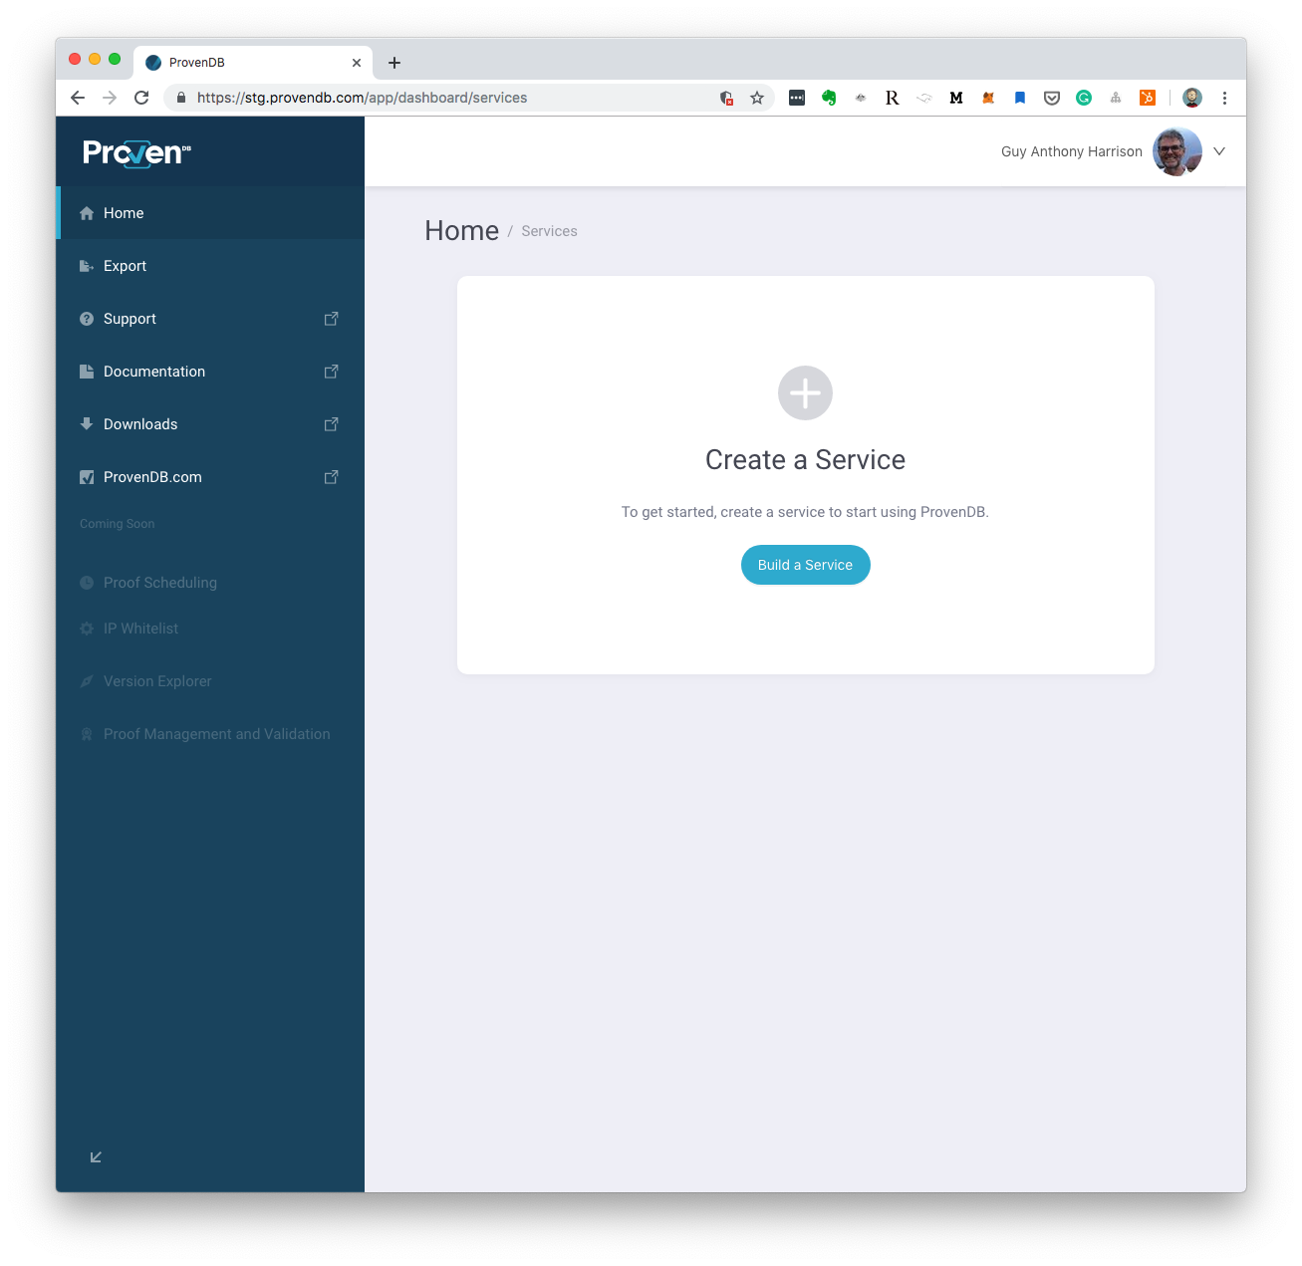
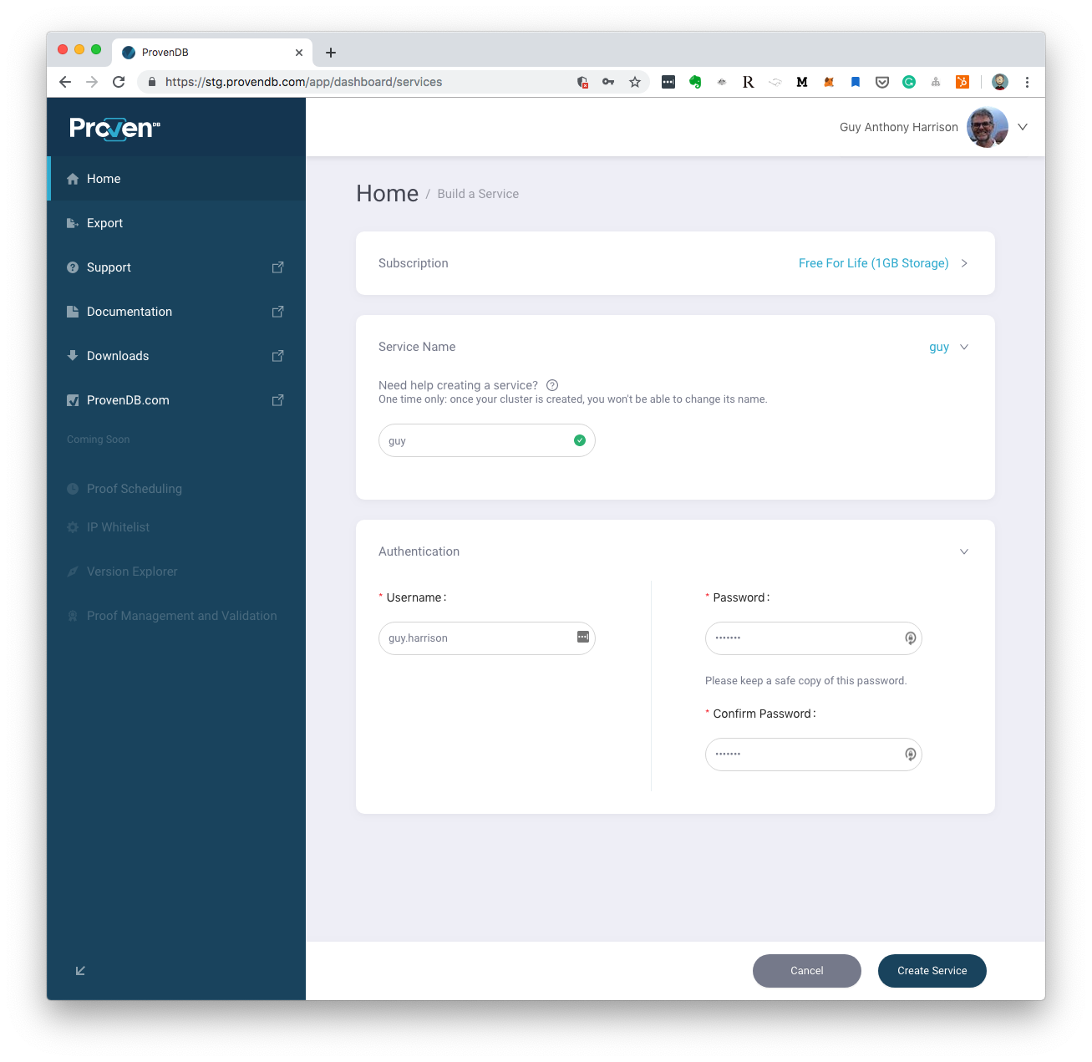
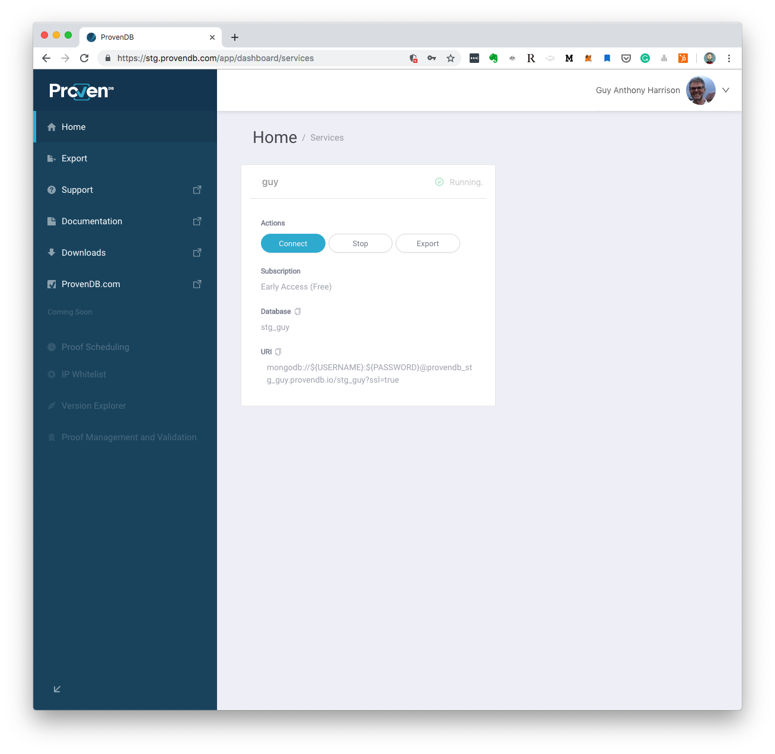
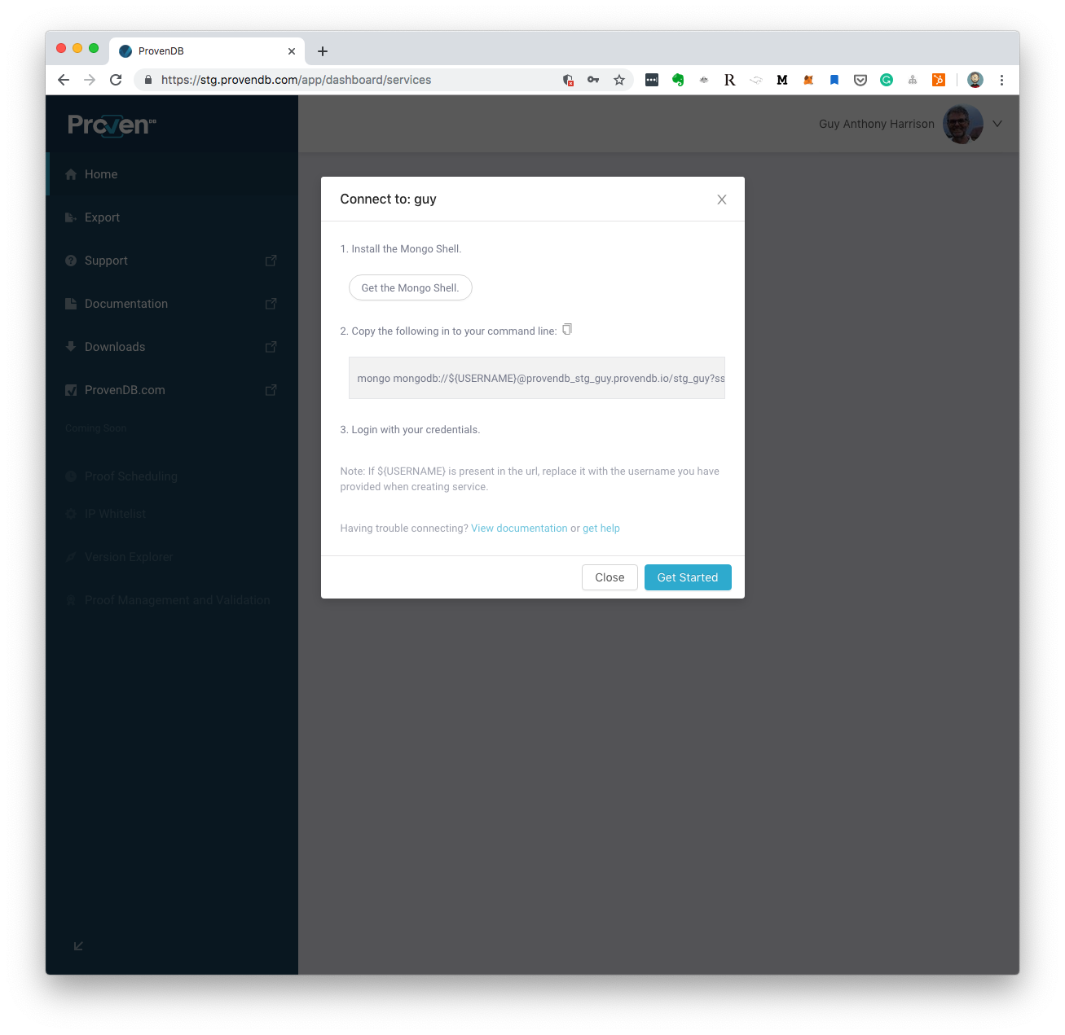
Easy on-boarding

